Slide 1



Electrical Meeting 1
1

Slide 2
Introduction
5
1

Slide 3
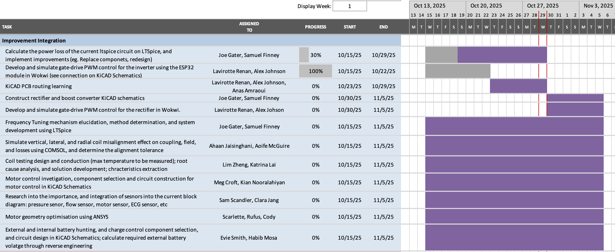
Progress Update
9

Slide 4
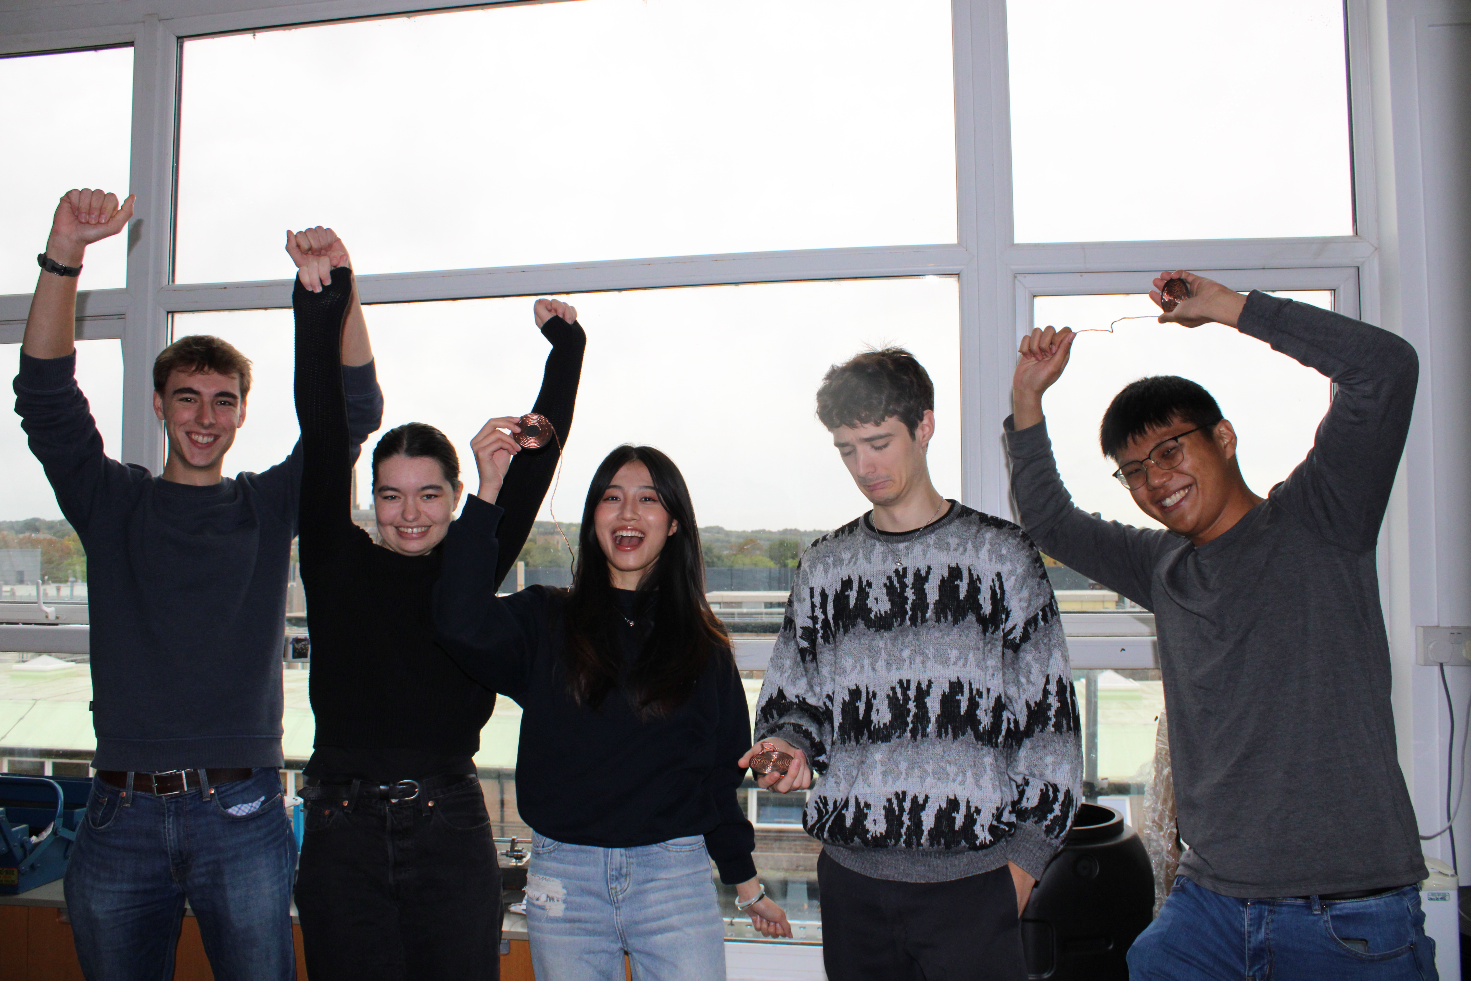
Social Event
Thursday, October 30th
8pm
Head of Steam (top bar)
7

Slide 5
Thank you for your hard work!
9
1

